Slide 1




EMG Based Hand Movement Classification using Time-Frequency Features
Group Members :-
Surya Naidu S20200020284
Vidya Sagar S20200020312
Eswar Adapa S20200020241

Slide 2


Outline
Motivation
Methodology
Procedure
Confusion Matrix ROC
Results
Conclusion
References

Slide 3
Motivation
Exoskeleton and wearable robots are playing an important role in people’s lives with limb disability and other physical disabilities.
The exoskeleton can help people with disabilities by helping them recover faster.
One of the most appreciated and successful method is to use sEMG signals, extracting them from the subjects and understanding the information/pattern from these signals, which in turn act as feedback to the robot.
This process starts by extracting the sEMG signals from the muscles of the subjects, the study of these signal should be able to communicate the actual intentions of the brain and then this information can then be carried to the exoskeleton/robot.
The primary goal here is to understand/decode the information/pattern involved with the signal.
For this task we are using many pattern recognition techniques.

Slide 4
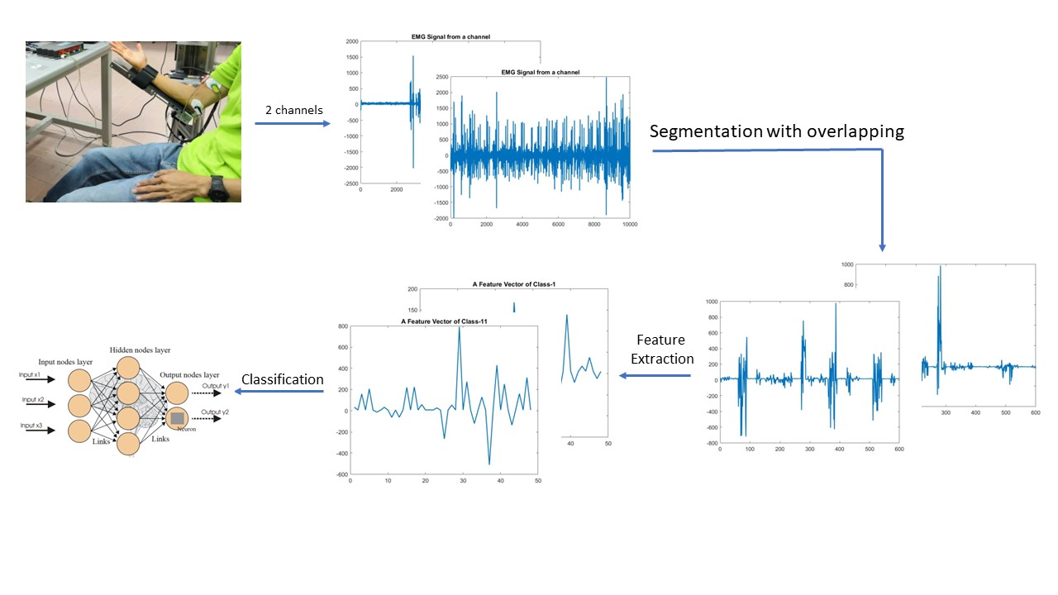
Methodology

Slide 5
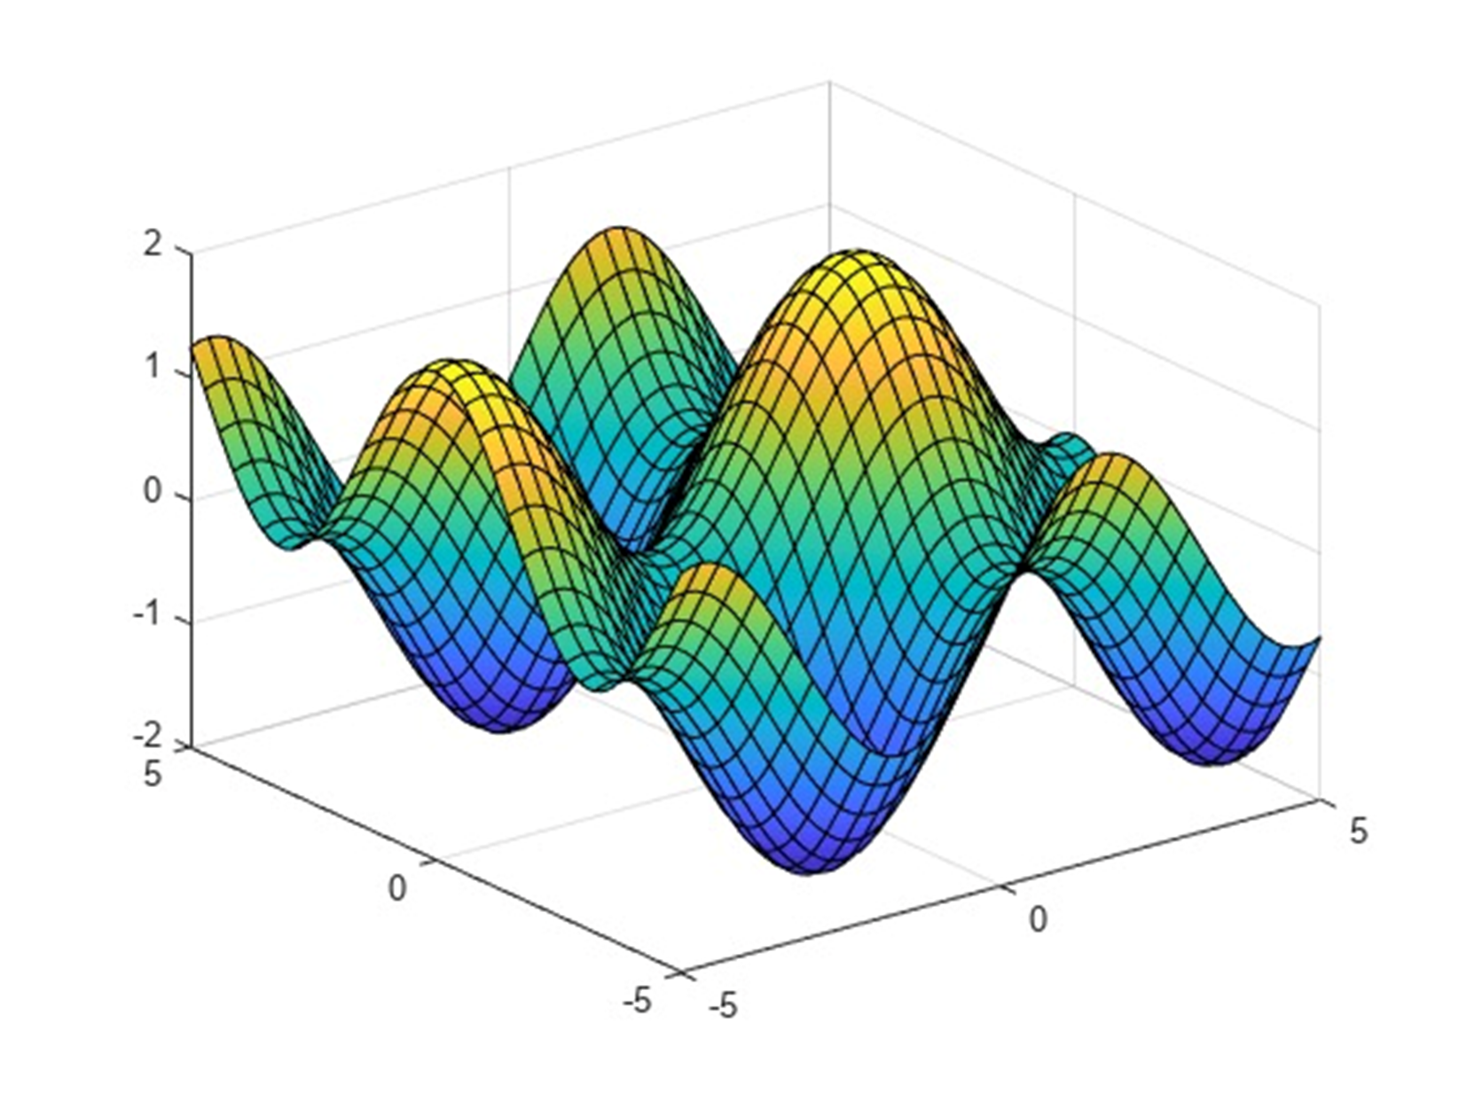
Features
The number of Instances and number of Attributes are 3000 and 2500 respectively
Features used are -
IEMG,
Zero Crossing (ZC),
Slope Sign Changes (SSC),
Waveform Length(WL),
Willison Amplitude (WAMP).
Variance
Skewness
Kurtosis
Median
Standard deviation

Slide 6
Procedure
Data is collected from 2 channels
Segmentation of signal with Window size 300 and overlap 50
EMD segmentation and Hilbert Transform of the first 3 IEMD
signals
Feature Extraction
Classification using FFNN with a hidden neurons of 10
Fine Tuning

Slide 7
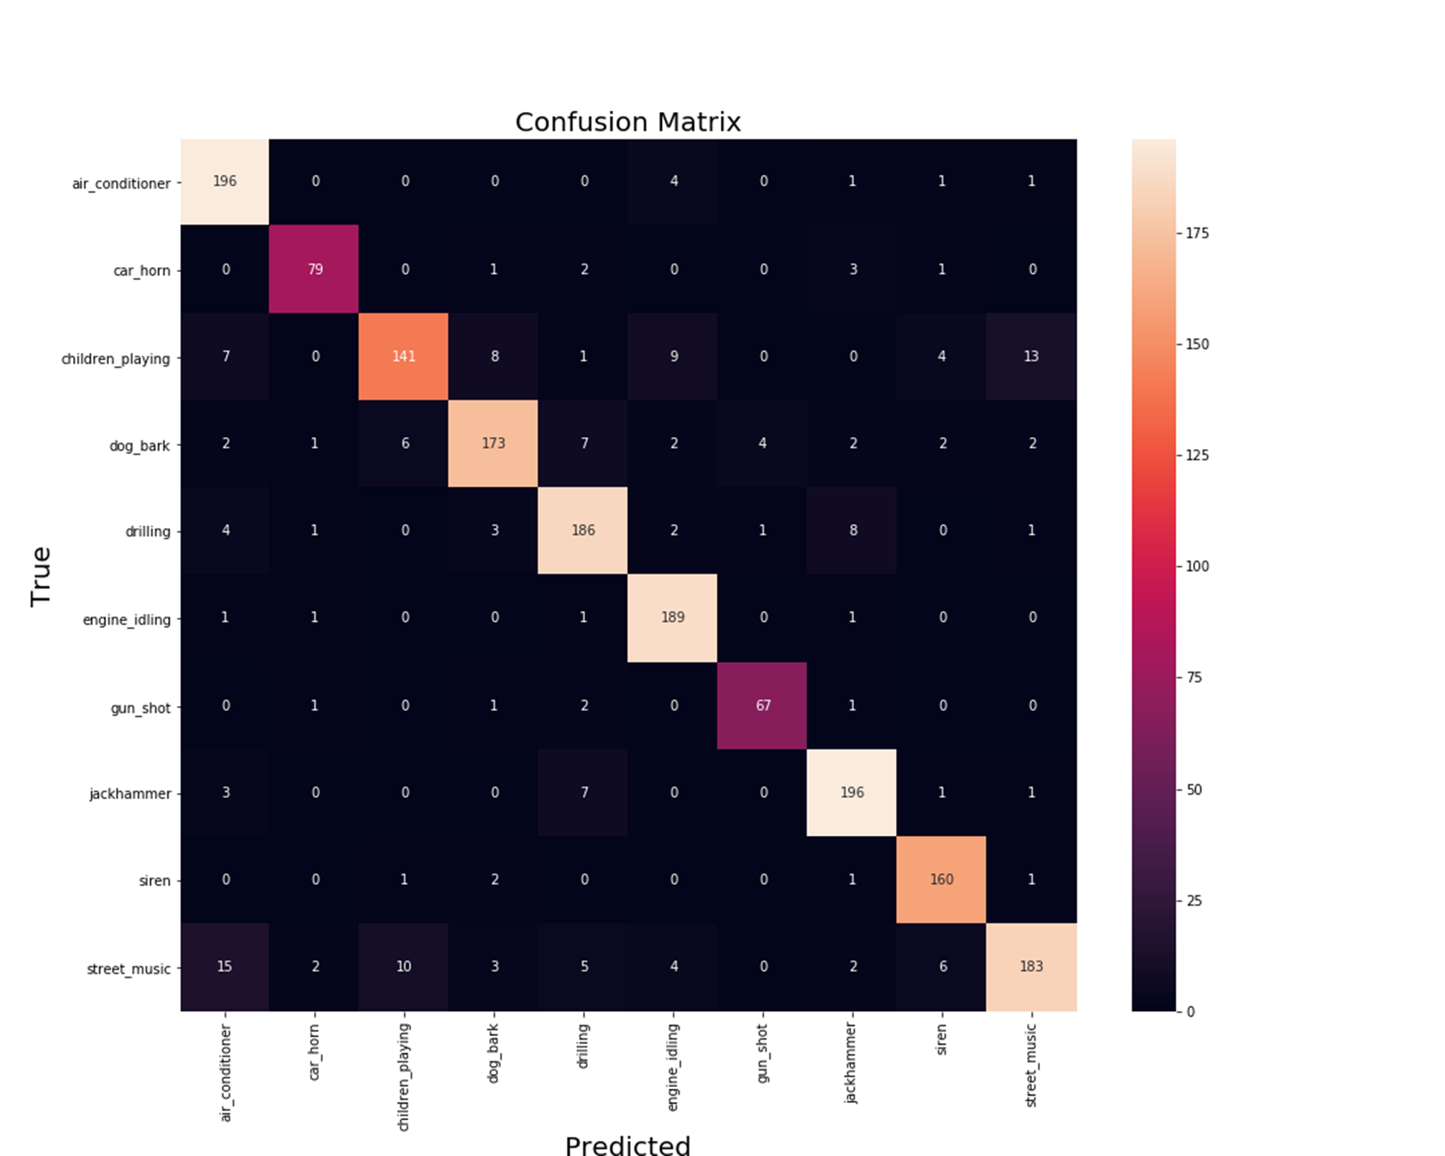
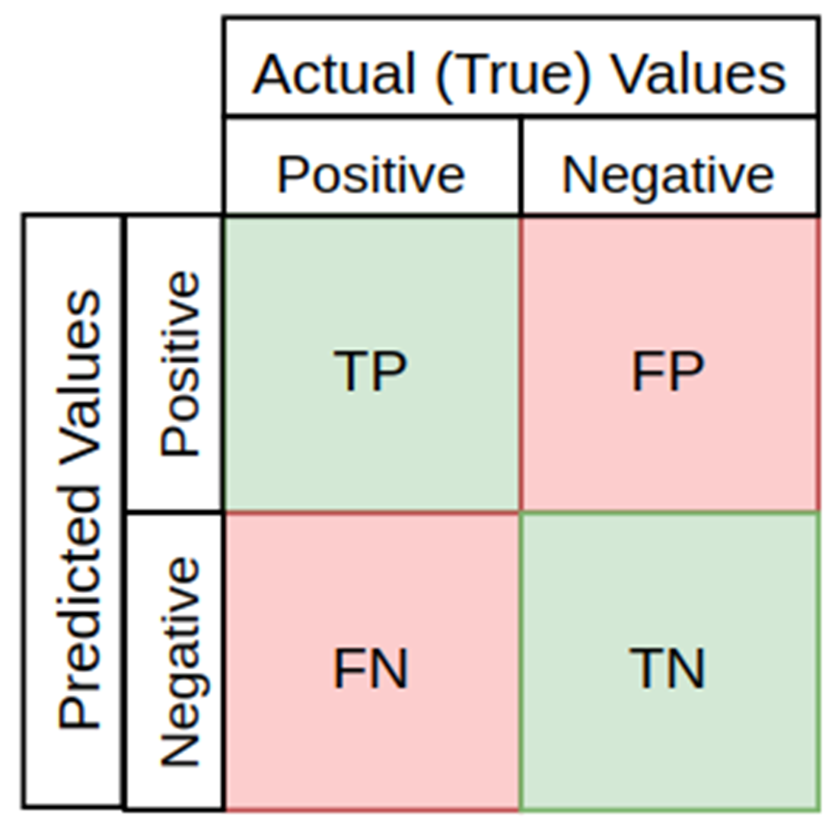
Confusion Matrix
A confusion matrix sometimes used to illustrate classifier performance based on the above four values (TP,FP,TN,FN).

Slide 8
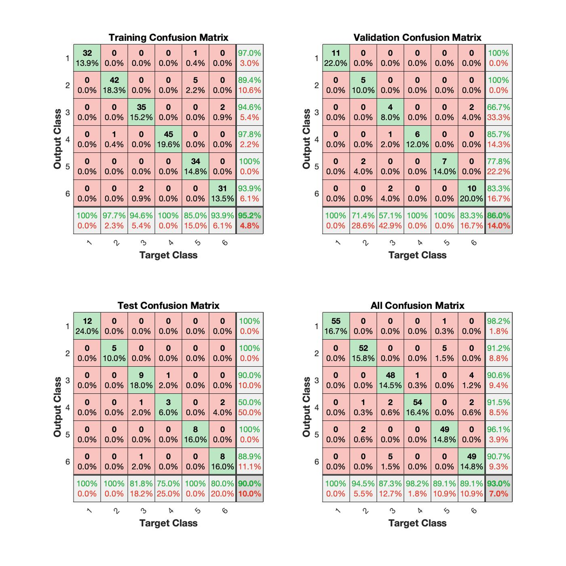
Confusion Matrix for Subject-1

Slide 9
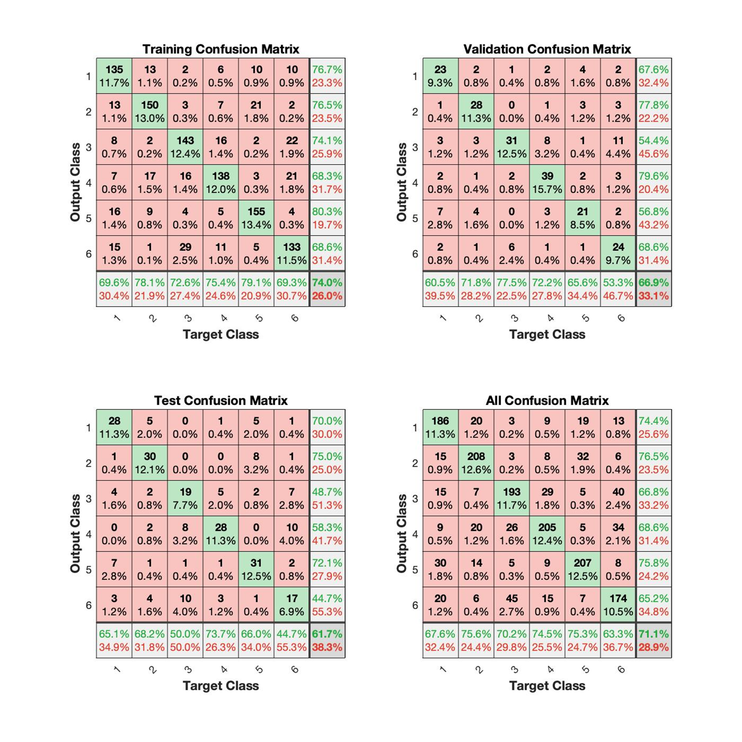
Confusion Matrix for all Subjects

Slide 10
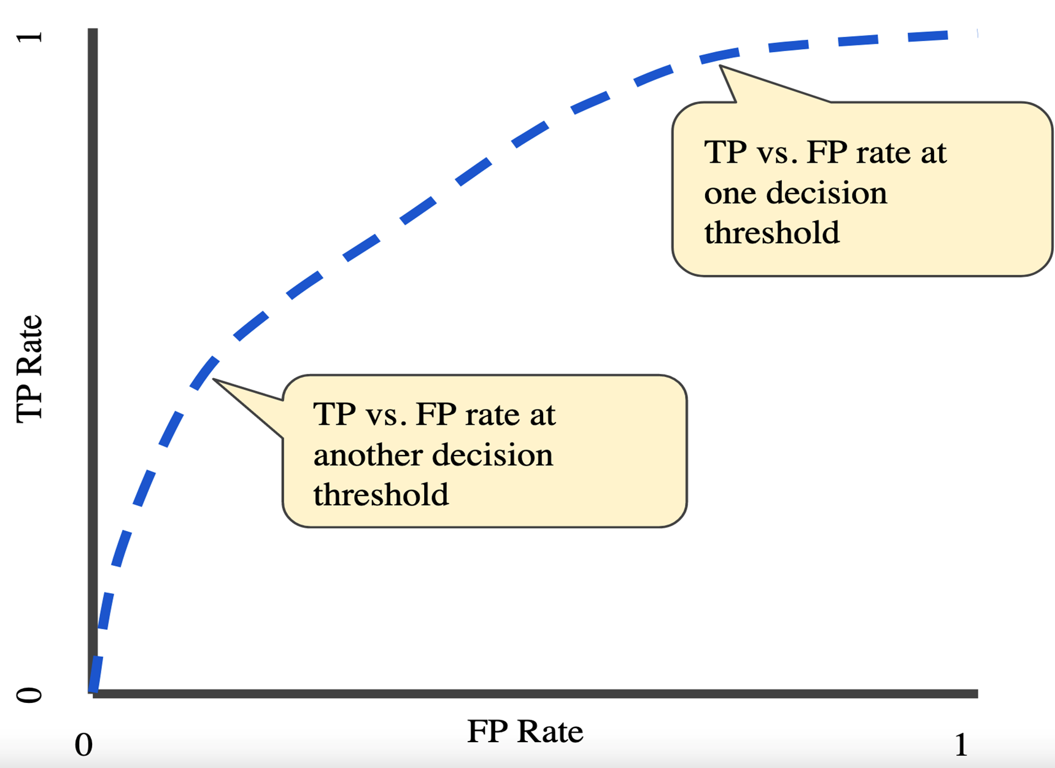
ROC
An ROC curve(receiver operating characteristic curve) is a graph showing the performance of a classification model at all classification thresholds .
This curve plot two parameters :-
(a) True Positive Rate
(b) False Positive Rate

Slide 11
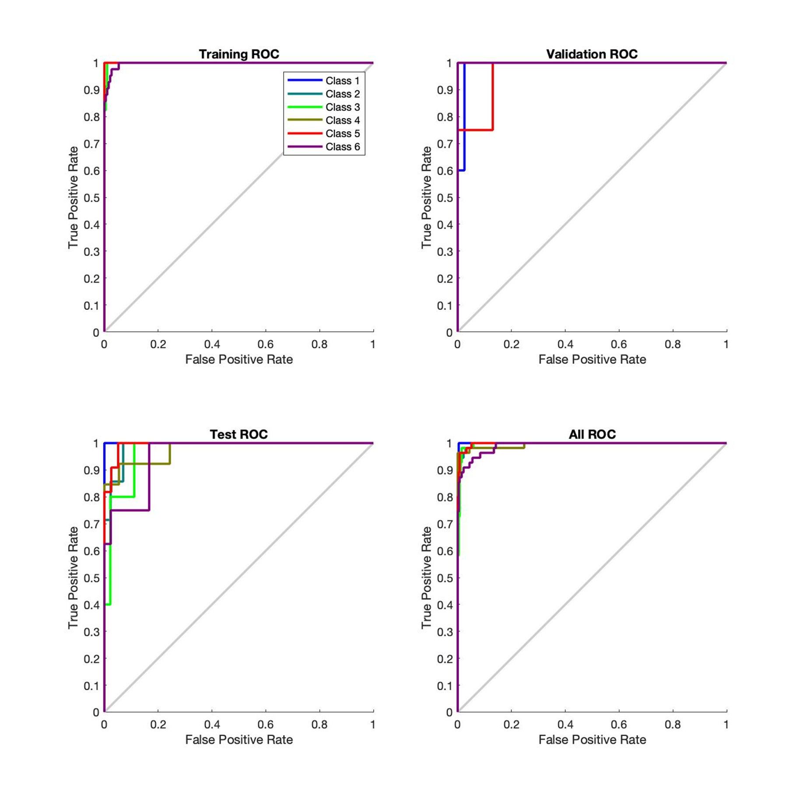
ROC for Subject-1

Slide 12
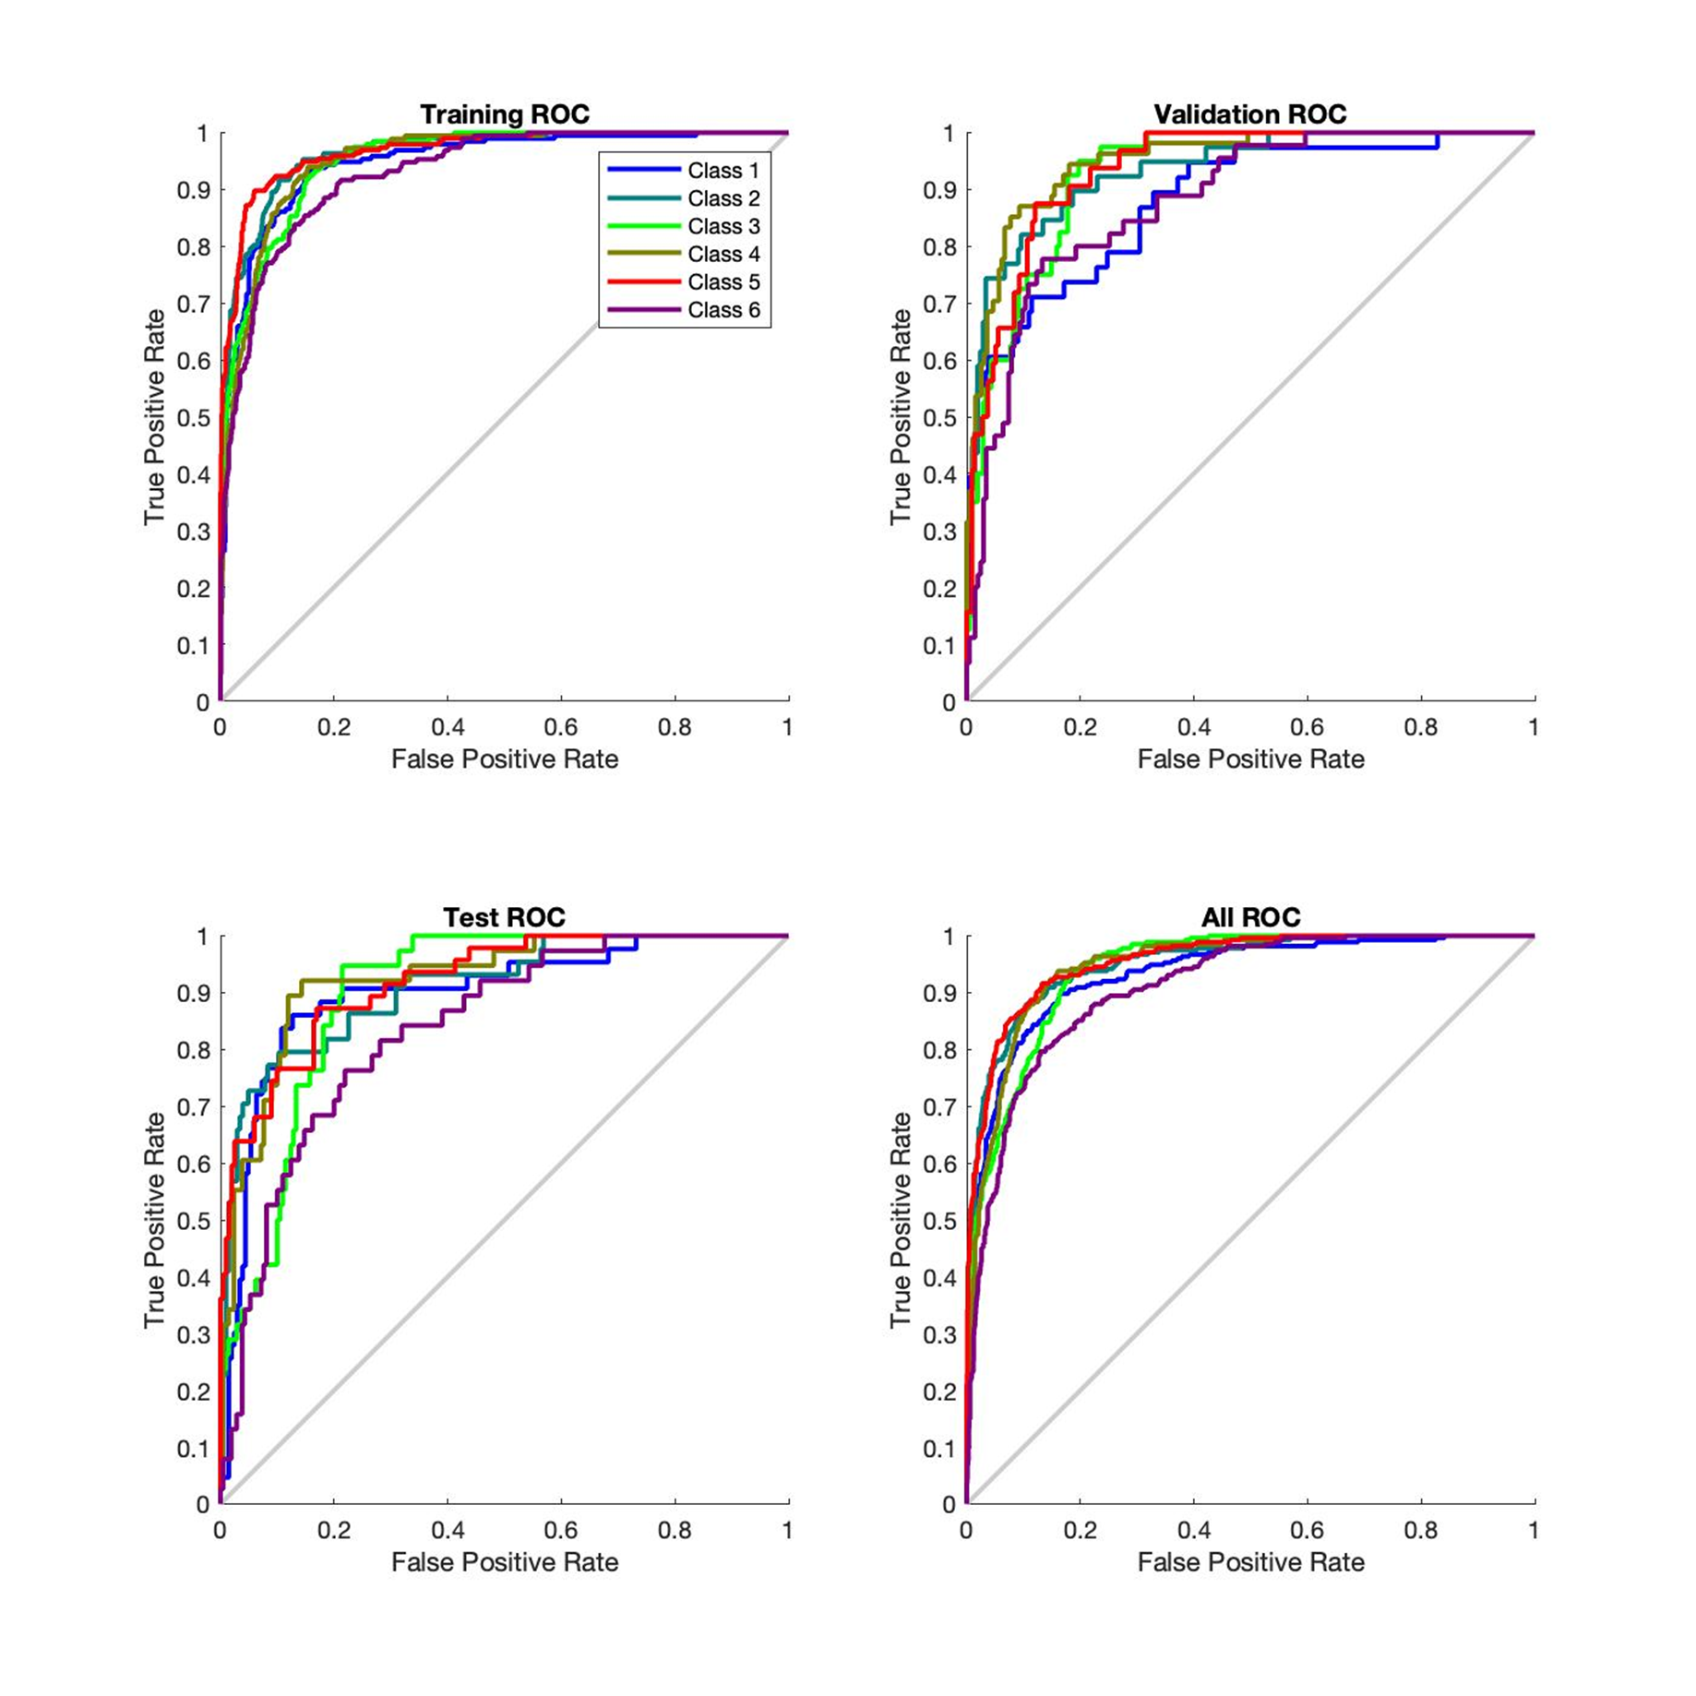
ROC for All Subjects

Slide 13

Results
This model achieved an accuracy of 95% for Subject 1 and has performed similarly for other 4 subject as well
The model has achieved an accuracy of 74% for all the 5 subjects together

Slide 14

Conclusion
In our study we have used FFNN and achieved an accuracy of 74% for all the subjects.
The project will be extended to implement various classification algorithms like k-NN, SVM, Decision Trees and other performance metrics like F1-Score, Precision, Recall, Specificity.

Slide 15


